Slide 1
Post- mortem inspection
By
Dr.Zainab abdul hussein

Slide 2
Postmortem examination/inspection refers to inspection of carcass and organs by qualified veterinarians to ensure that carcass and organs are fit for human consumption. It takes blasé after anti –mortem (after death).
- During inspection care should be taken not to contaminate the carcass and organs from diseased animals.
- The knives and other instruments used for cutting and examining organs, should be properly sterilized before and after use.
- The particular sequence should be followed during postmortem examination so that each carcass and there of organs are checked thoroughly.
- Carcasses should not be sent to the chilling section without inspection after dressing. Some of the diseases are not apparent during ante mortem examination can be detected easily in postmortem examination.

Slide 3
Postmortem inspection should provide necessary information for the scientific
evaluation of pathological lesions of meat.
Professional and technical knowledge must be fully utilized by:
1-Viewing, incision, palpation and olfaction techniques.
2- Classifying the lesions into one of two major categories - acute or chronic.
3- Condition is localized or generalized, and the extent of systemic changes in other organs or tissues.
4- Determine the significance of primary and systemic pathological lesions and their relevance to major organs and systems, particularly the liver, kidneys, heart, spleen and lymphatic system.
5- Coordinating all the components of ante mortem and postmortem findings to make a final diagnosis.
6- Submitting the samples to the laboratory for diagnostic support, if abattoir has
holding and refrigeration facilities for carcasses under detention..

Slide 4
Localized versus generalized conditions
It is important to differentiate between a localized or a generalized condition in the judgement of an animal carcass. In a localized condition, a lesion is restricted by the animal defense mechanisms to a certain area or organ. Systemic changes associated with a localized condition may also occur. Example: jaundice caused by liver infection or toxaemia following pyometra (abscess in the uterus).
In a generalized condition, the animal's defense mechanisms are unable to stop the spread of the disease process by way of the circulatory or lymphatic systems. The lymph nodes of the carcass should be examined if pathological lesions are generalized.

Slide 5
Acute versus chronic conditions
Acute conditions
An acute condition implies that a lesion has developed over a period of some days, whereas a chronic condition implies the development of lesions over a period of some weeks, months or years. A subacute condition refers to a time period between an acute and chronic condition.
The acute stage is manifested by inflammation of different organs or tissues, enlarged haemorrhagic lymph nodes and often by petechial haemorrhage of the mucosal and serous membranes and different organs such as heart, kidney and liver. An acute stage parallels with the generalized disease complex, when an acute infection tends to overcome the animal's immune system and becomes generalized

Slide 6
chronic conditions
In a chronic condition, inflammation associated with congestion is replaced by adhesions, necrotic and fibrotic tissue or abscesses. The judgement in the chronic stage is less severe and frequently the removal of affected portions is required without the condemnation of the carcass..

Slide 7
Examine carcasses (including musculature, exposed bones, joints, tendon sheaths etc.) To determine any signs of disease or defect. Attention should be paid to bodily condition, efficiency of bleeding, color, condition of serous membranes (pleura and peritoneum), cleanliness and presence of any unusual odors.
Lymph nodes
Superficial inguinal (male).
Palpate supra-mammary (female).
Palpate external and internal iliac.
Palpate prepectoral.
Palpate popliteal.
Palpate(only sheep/goats And game/antelope)renal.
Palpate (cattle, horses, pigs) or incise if diseases is suspected. Prescapular &prefemoral palpate (only sheep and goats).

Slide 8
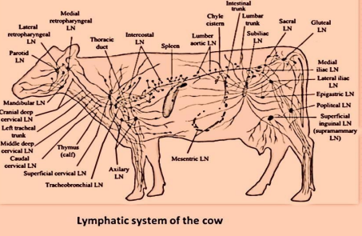

Slide 9
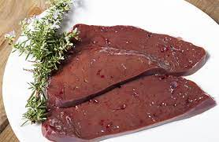
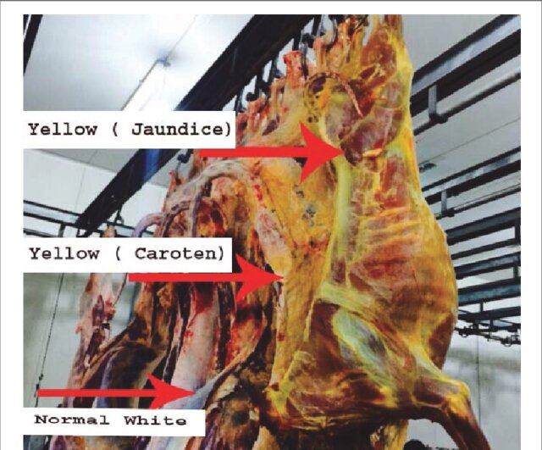
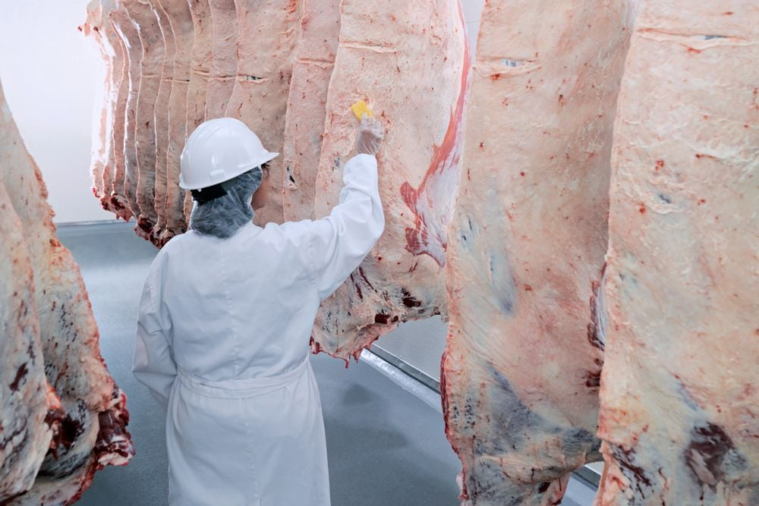
Examination of carcasses
1-External examination and subcutaneous tissue
2-examination of thorasic cavity.
3-examination of abdominal cavity.

Slide 10
POSTMORTEM JUDGEMENT
Similar to ante-mortem examination, a competent veterinarian has to submit its judgement report regarding the fate of carcass and its offal. The decision is based on visual observation, palpation, smell, ante-mortem signs and the results of laboratory test, if any. The statement of judgement may be either of the following:
1-Fit for human consumption.
2-Unfit for human consumption or total condemnation.
3-The affected organs must be condemned while rest can be passed for human consumption (partially condemned).
4-Approved for human consumption with conditions-distribution restricted to limited or small amount to a consumer with instruction.

Slide 11
Characteristic Signs For The Animals Dead
1. The flesh is dark, there is capillary bleeding, the organs, particularly liver, lungs and kidneys, are dark and congested and when cut, blood runs out.
2. The intercostal veins are full of blood and are clearly visible
3. The forelegs often tend to be ‘tucked up’
4. The carcass sets badly and decomposes rapidly
.

